Slide 1
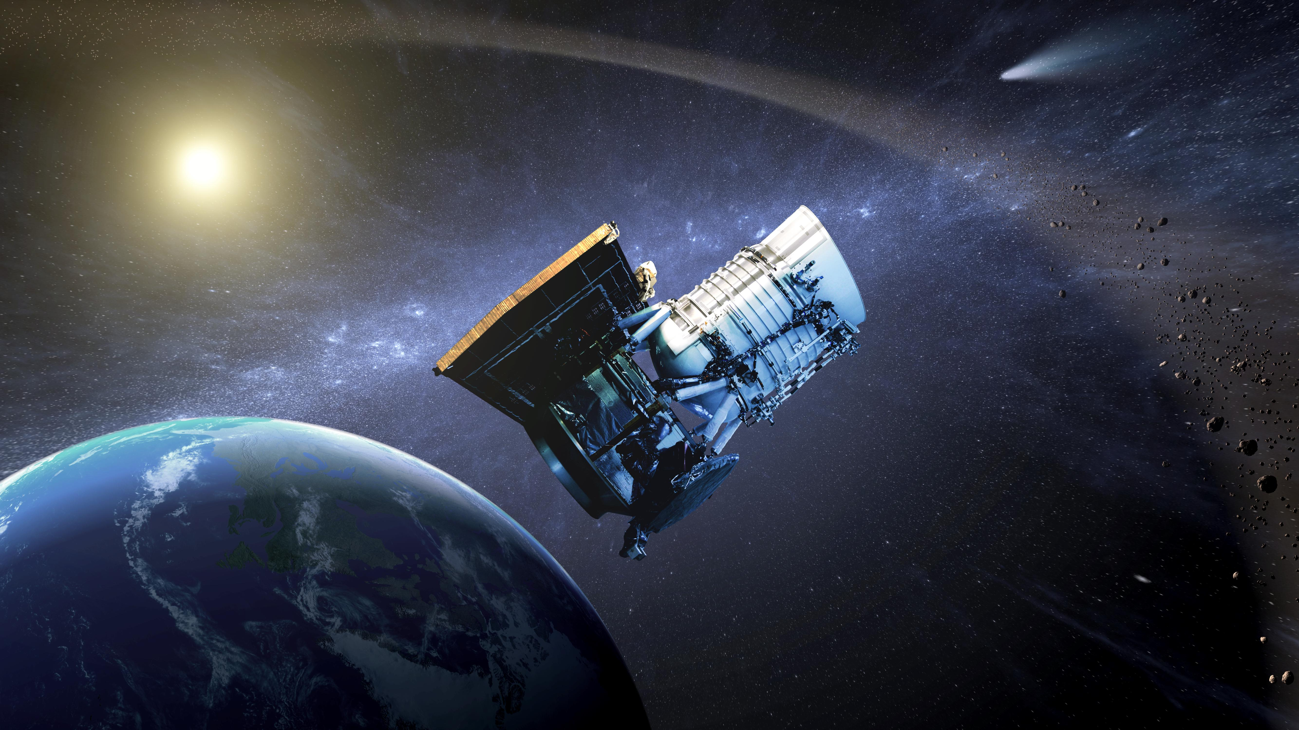
NEOWISE: Overview and recent results
Joseph Masiero (NASA JPL/Caltech)
10/10/2016
In collaboration with: Amy Mainzer, James Bauer, Roc Cutri, Tommy Grav, Emily Kramer, Carrie Nugent, Sarah Sonnett, Ned Wright, and the NEOWISE team.
Copyright 2016. All rights reserved.

Slide 2
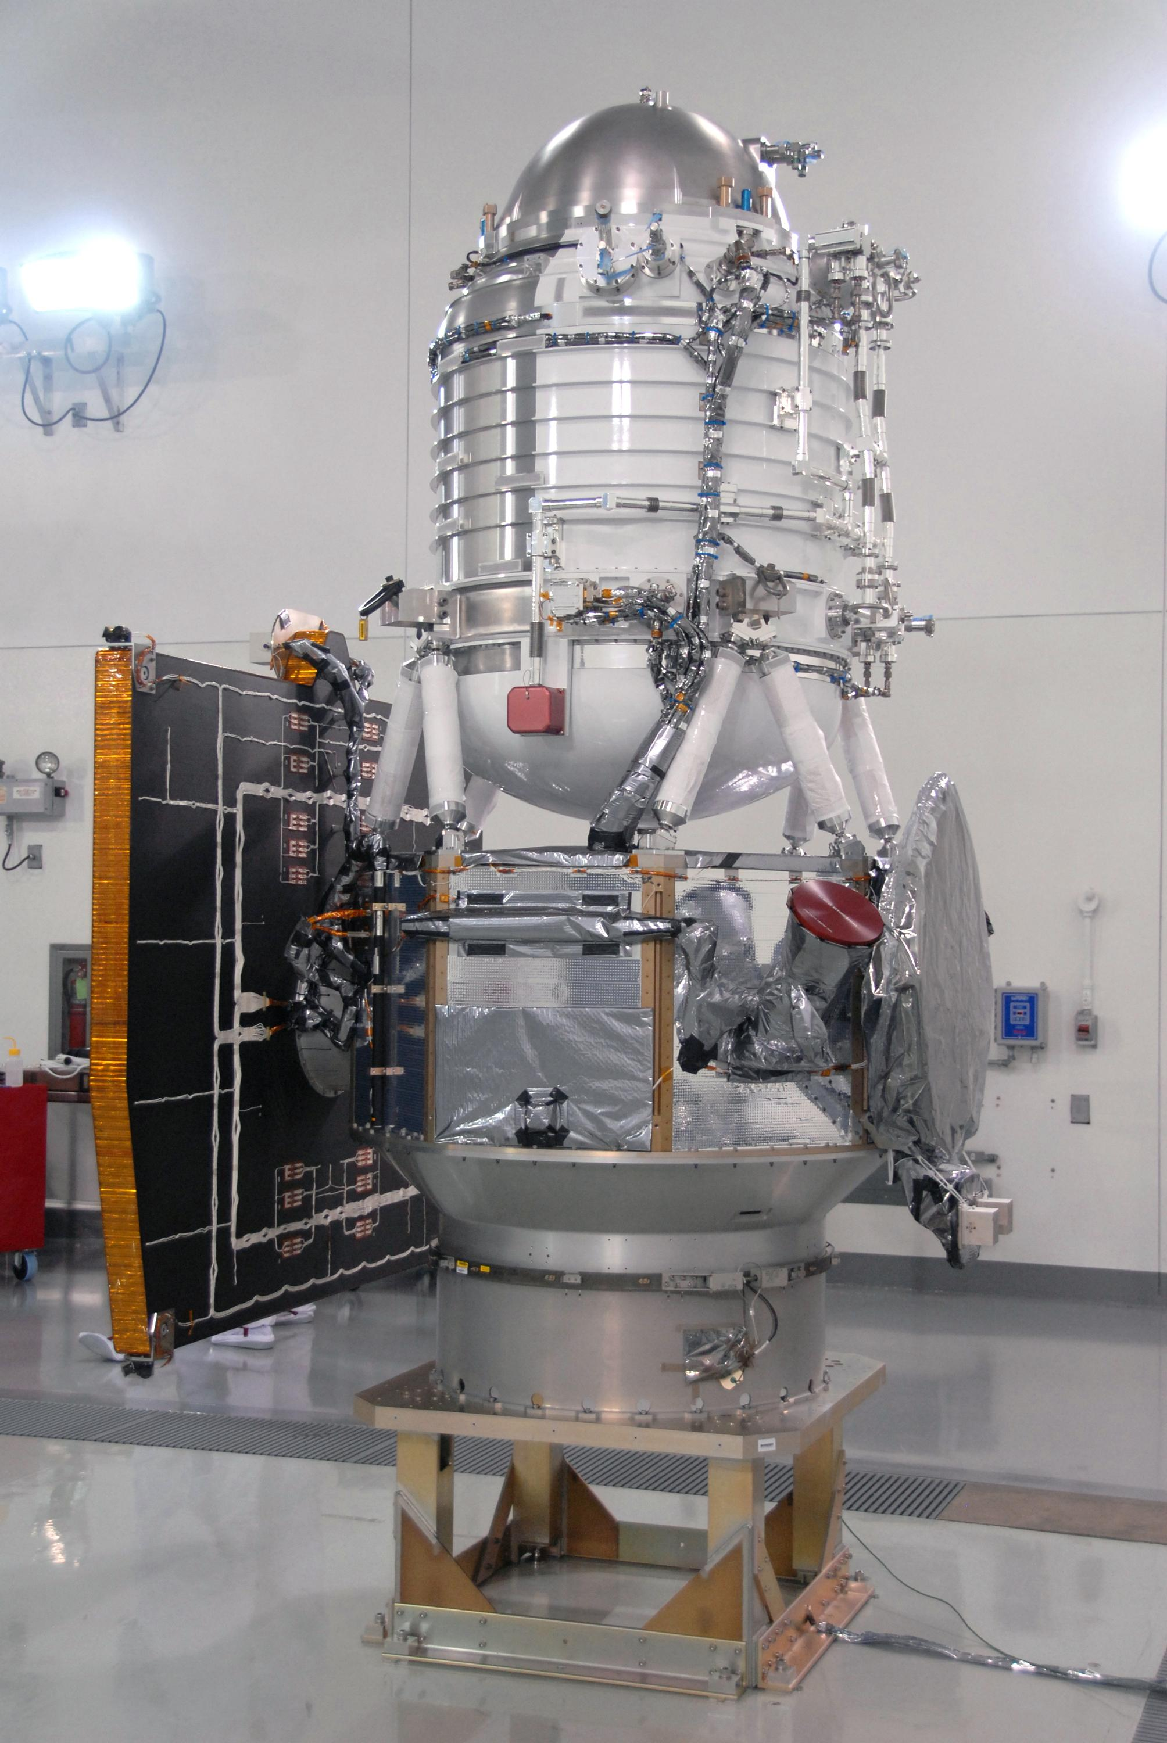
NEOWISE: Origin Story
PI-led (PI: Amy Mainzer, JPL) mission under NEOO Program (Lindley Johnson, Program Exec)
Utilizes WISE spacecraft that was brought out of hibernation in October 2013
3.4 and 4.6 µm bands (W1 and W2) at 75K
Science operations: ~3 years starting 12/2013
NASA JPL
Science Goals:
Survey of NEOs at mid-infrared wavelengths
Discovery of new NEOs
Physical property characterizaion

Slide 3
The WISE mission
NASA Mid-class Explorer
3.4, 4.6, 12, 22 microns
Solid Hydrogen cryogen
Launched 14 Dec 2009 onto a polar, sun-synchronous orbit
Surveyed from 14 Jan 2010 to 30 Sept 2010, post-cryo to 1 Feb 2011
8 detections at ecliptic, rising to hundreds at the poles
PI: Ned Wright (UCLA)
NASA JPL

Slide 4
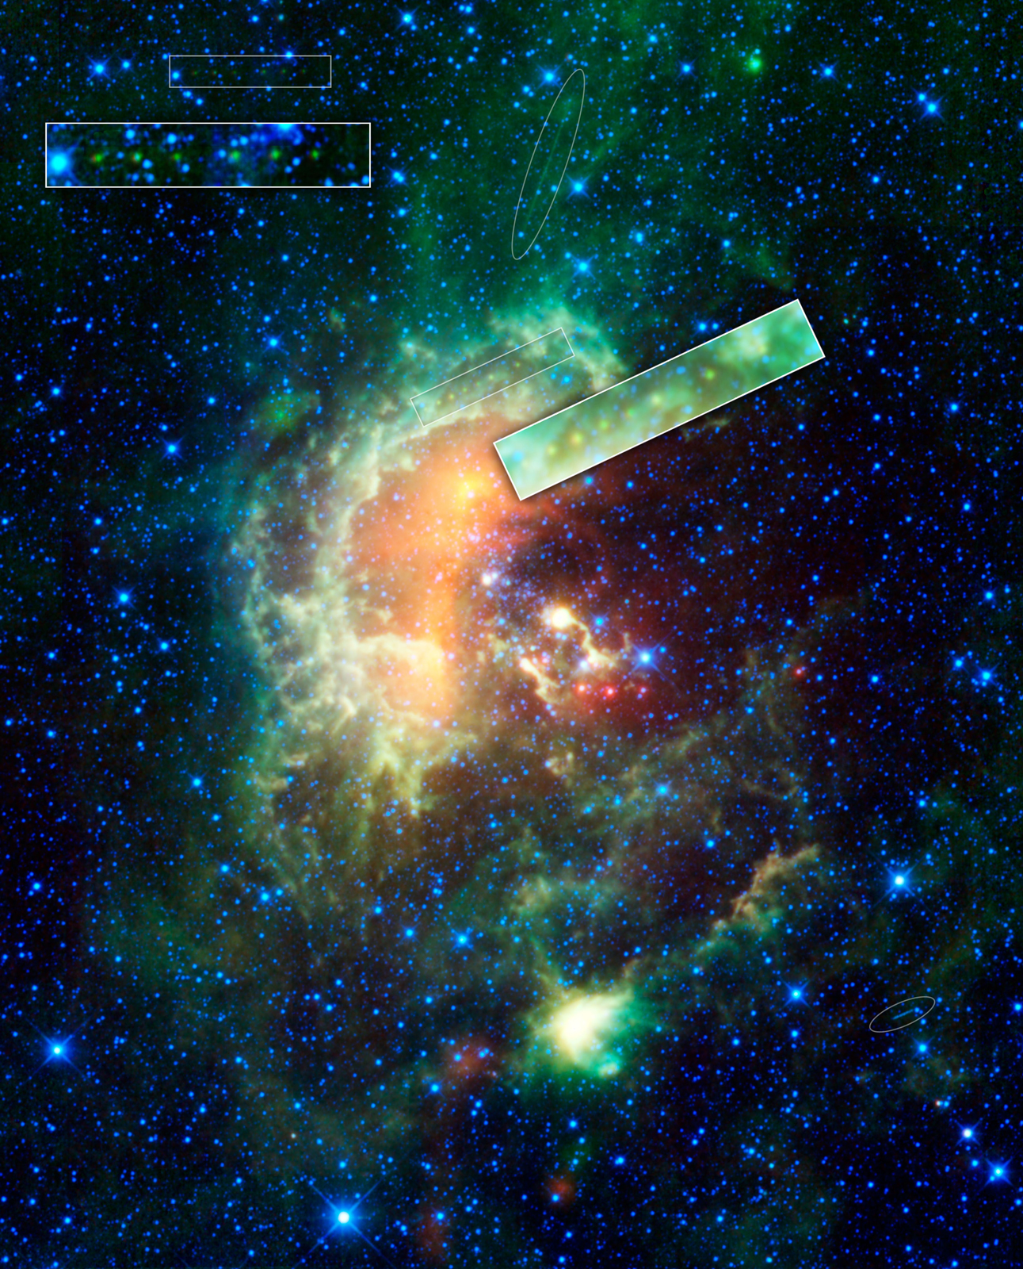
WISE single frame data
Original mission plan did not include archiving single frame data
However, asteroids are some of the brightest objects in mid-infrared sky
Solar system objects and stationary transients would have been lost
NASA JPL/IPAC

Slide 5
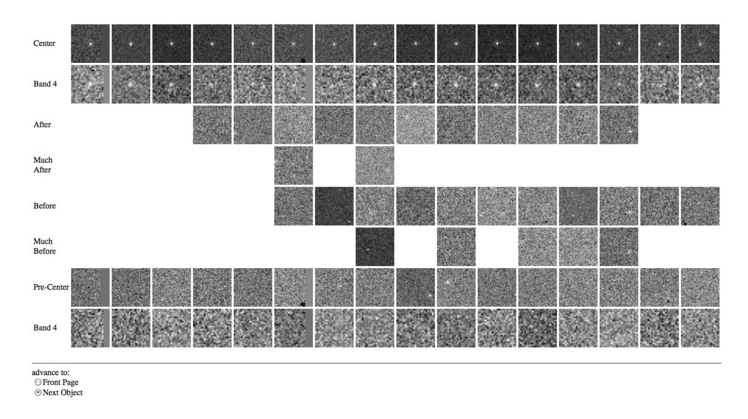
WISE Moving Object Processing System
Automated object detection and linking, combined with human QA

Slide 6
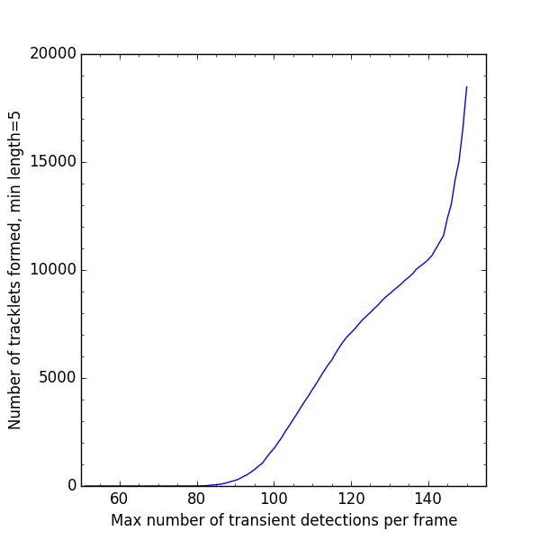
WMOPS
Tracklet combinatorics are non-linear

Slide 7
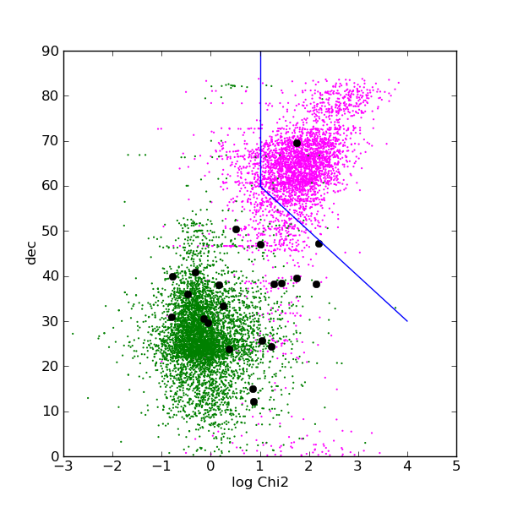
WMOPS
false
|Declination|
NEOs
real
chi² to a linear fit
Each survey has its own peculiarities

Slide 8
WISE: Solar System survey
NASA JPL
Top-down view of the inner Solar System. NEOs in red (new) and green (known); comets in yellow (new) and cyan (known), rest in black

Slide 9
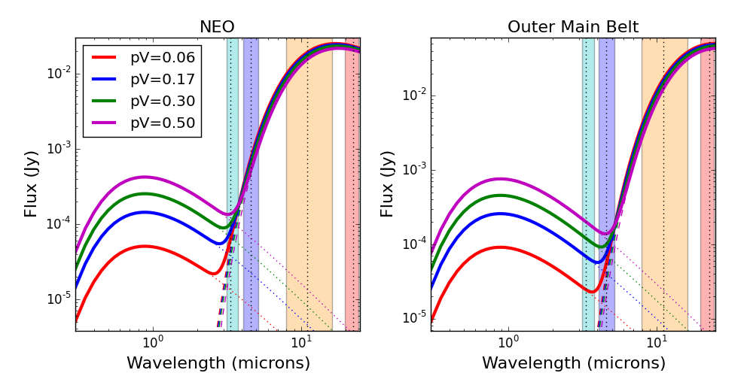
Determining asteroid diameters
Diameters constrained with thermal models
Literature optical data allow for albedo determination

Slide 10
NEOWISE survey: the first two years
NASA JPL
Top-down view of the inner Solar system. NEOs in green, comets in yellow, other asteroids in white

Slide 11
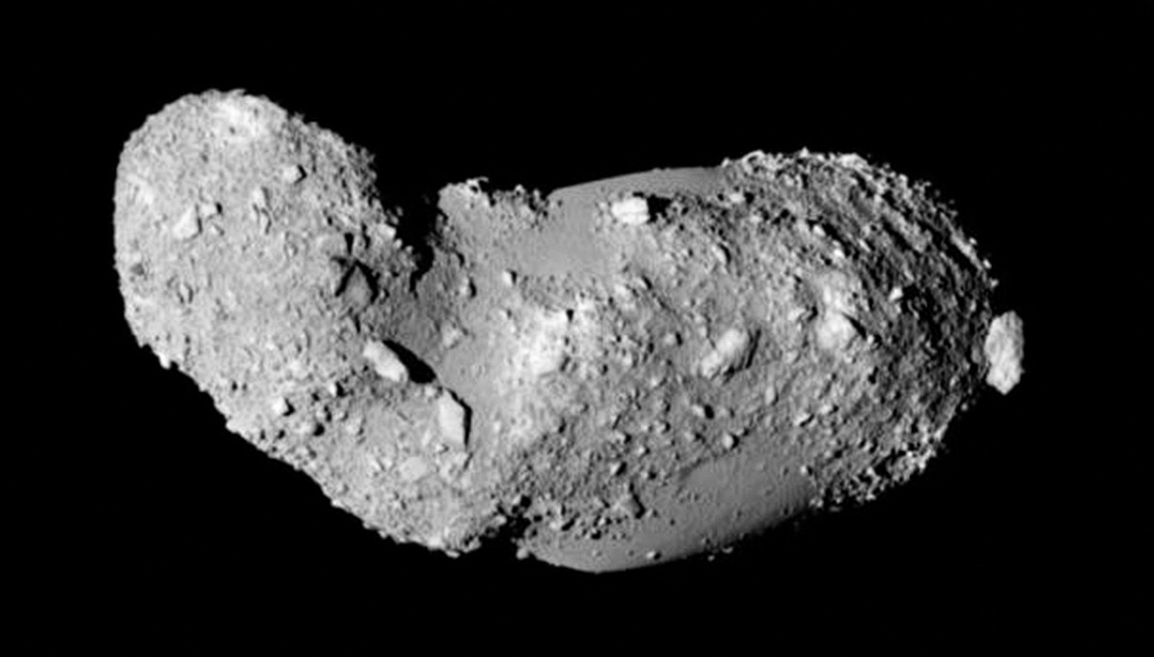
That’s great, but why NEOs?
NASA APOD/JAXA
Flyby image of NEO Itokawa from the Hayabusa spacecraft

Slide 12
NEOs come close
NEOWISE discovery images of NEO 2014 HQ₁₂₄

Slide 13
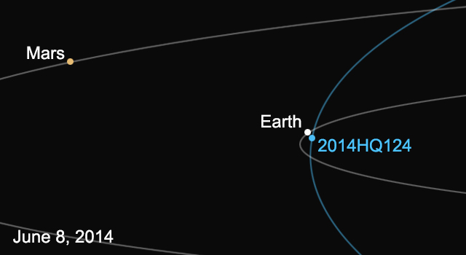
NEOs come close
NASA JPL
2014 HQ₁₂₄ at time of close pass with Earth (3 LD) in daytime sky
Diameter = 400 m
NASA JPL

Slide 14
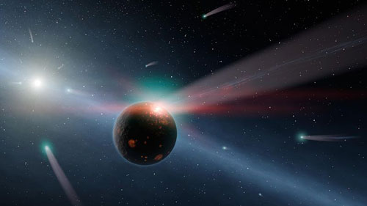
NEO delivery of volatiles/organics
NASA JPL
Low albedo asteroids and comets are rich in organics and volatiles

Slide 15
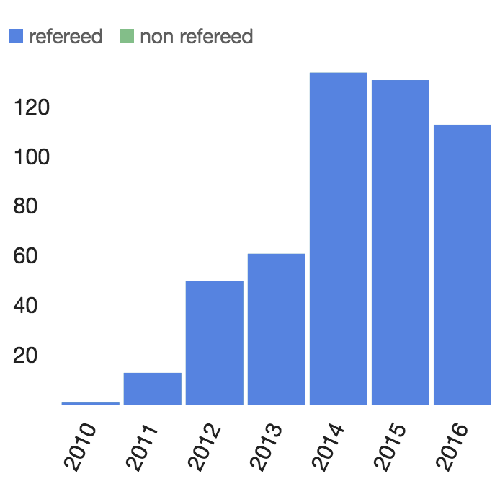
NEOWISE Science Results
To date over 500 publications have made use of NEOWISE single-frame data or NEOWISE-derived physical properties
Over 1800 publications have made use of data from all phases of the WISE mission.
Graph from ADS

Slide 16
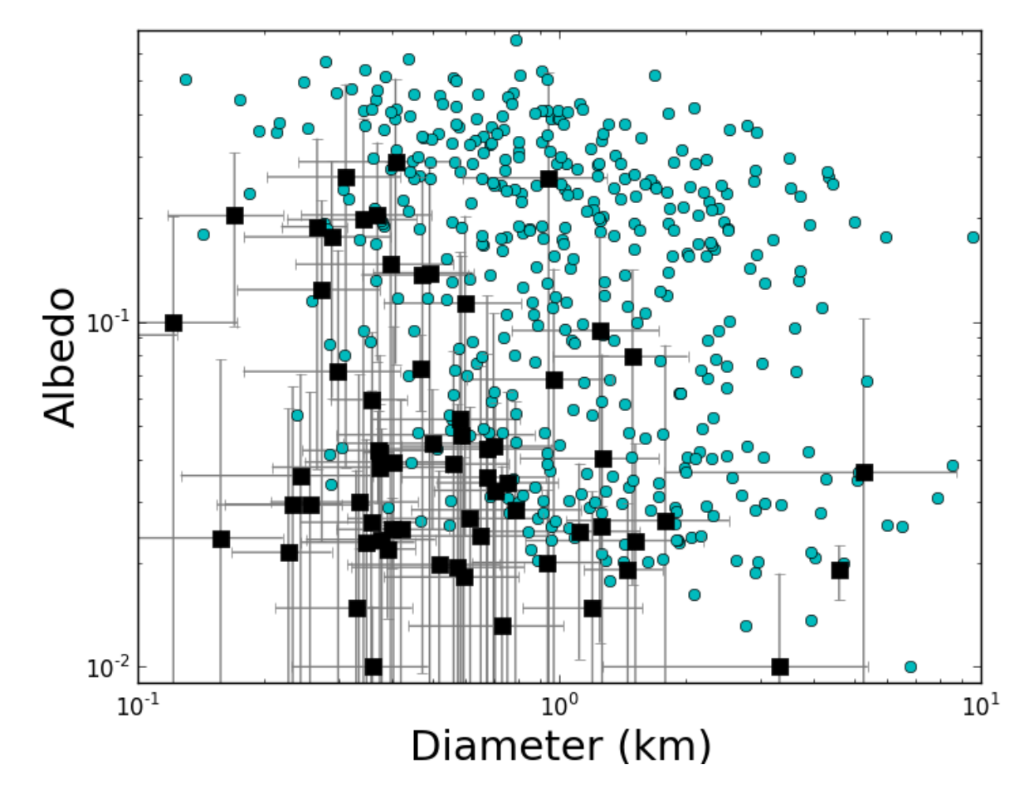
NEOWISE detections
Nugent et al. 2016
NEOWISE-Reactivation observations of known NEOs (cyan) and new NEO discoveries (black) in years 1&2

Slide 17
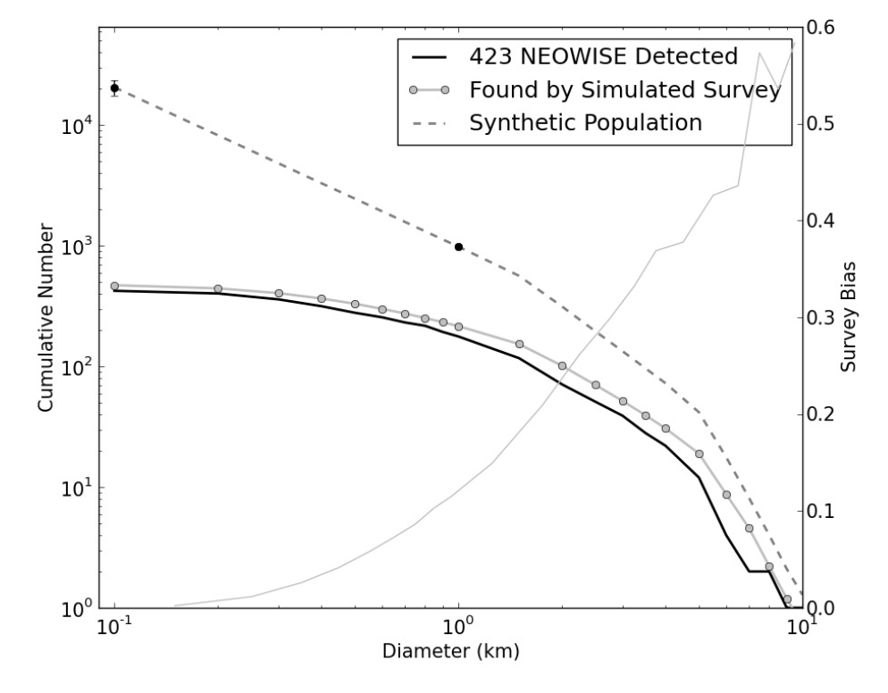
The number of NEOs
NEOWISE survey debiasing found 981±19 NEOs > 1 km
>90% currently known
Mainzer et al. 2011e

Slide 18
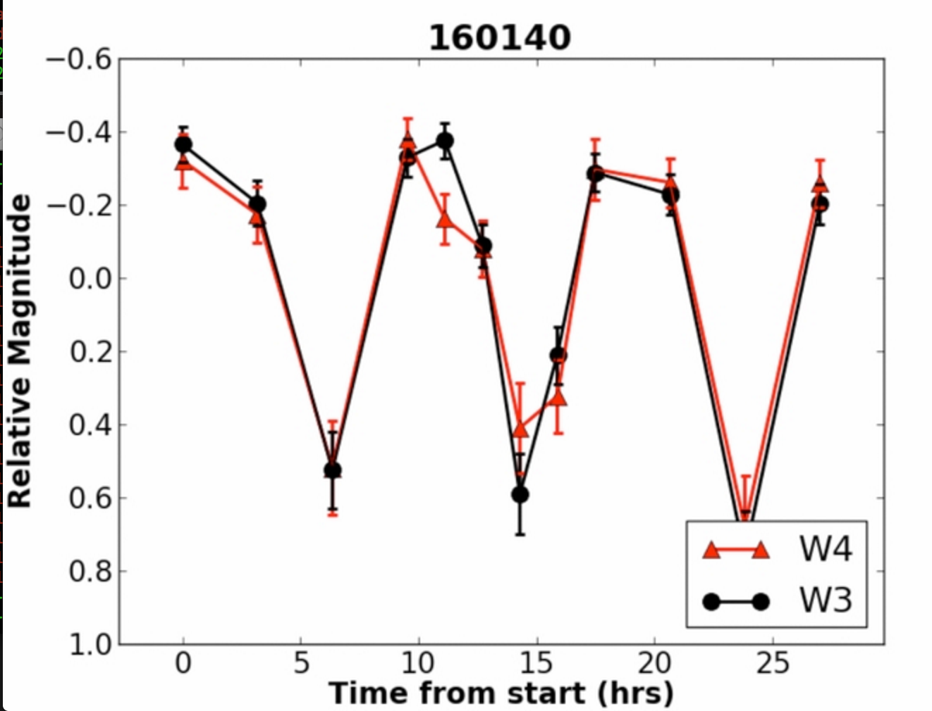
Asteroid Binarity
Sonnett et al. 2015
NEOWISE’s unique cadence enables searches for binary asteroids

Slide 19
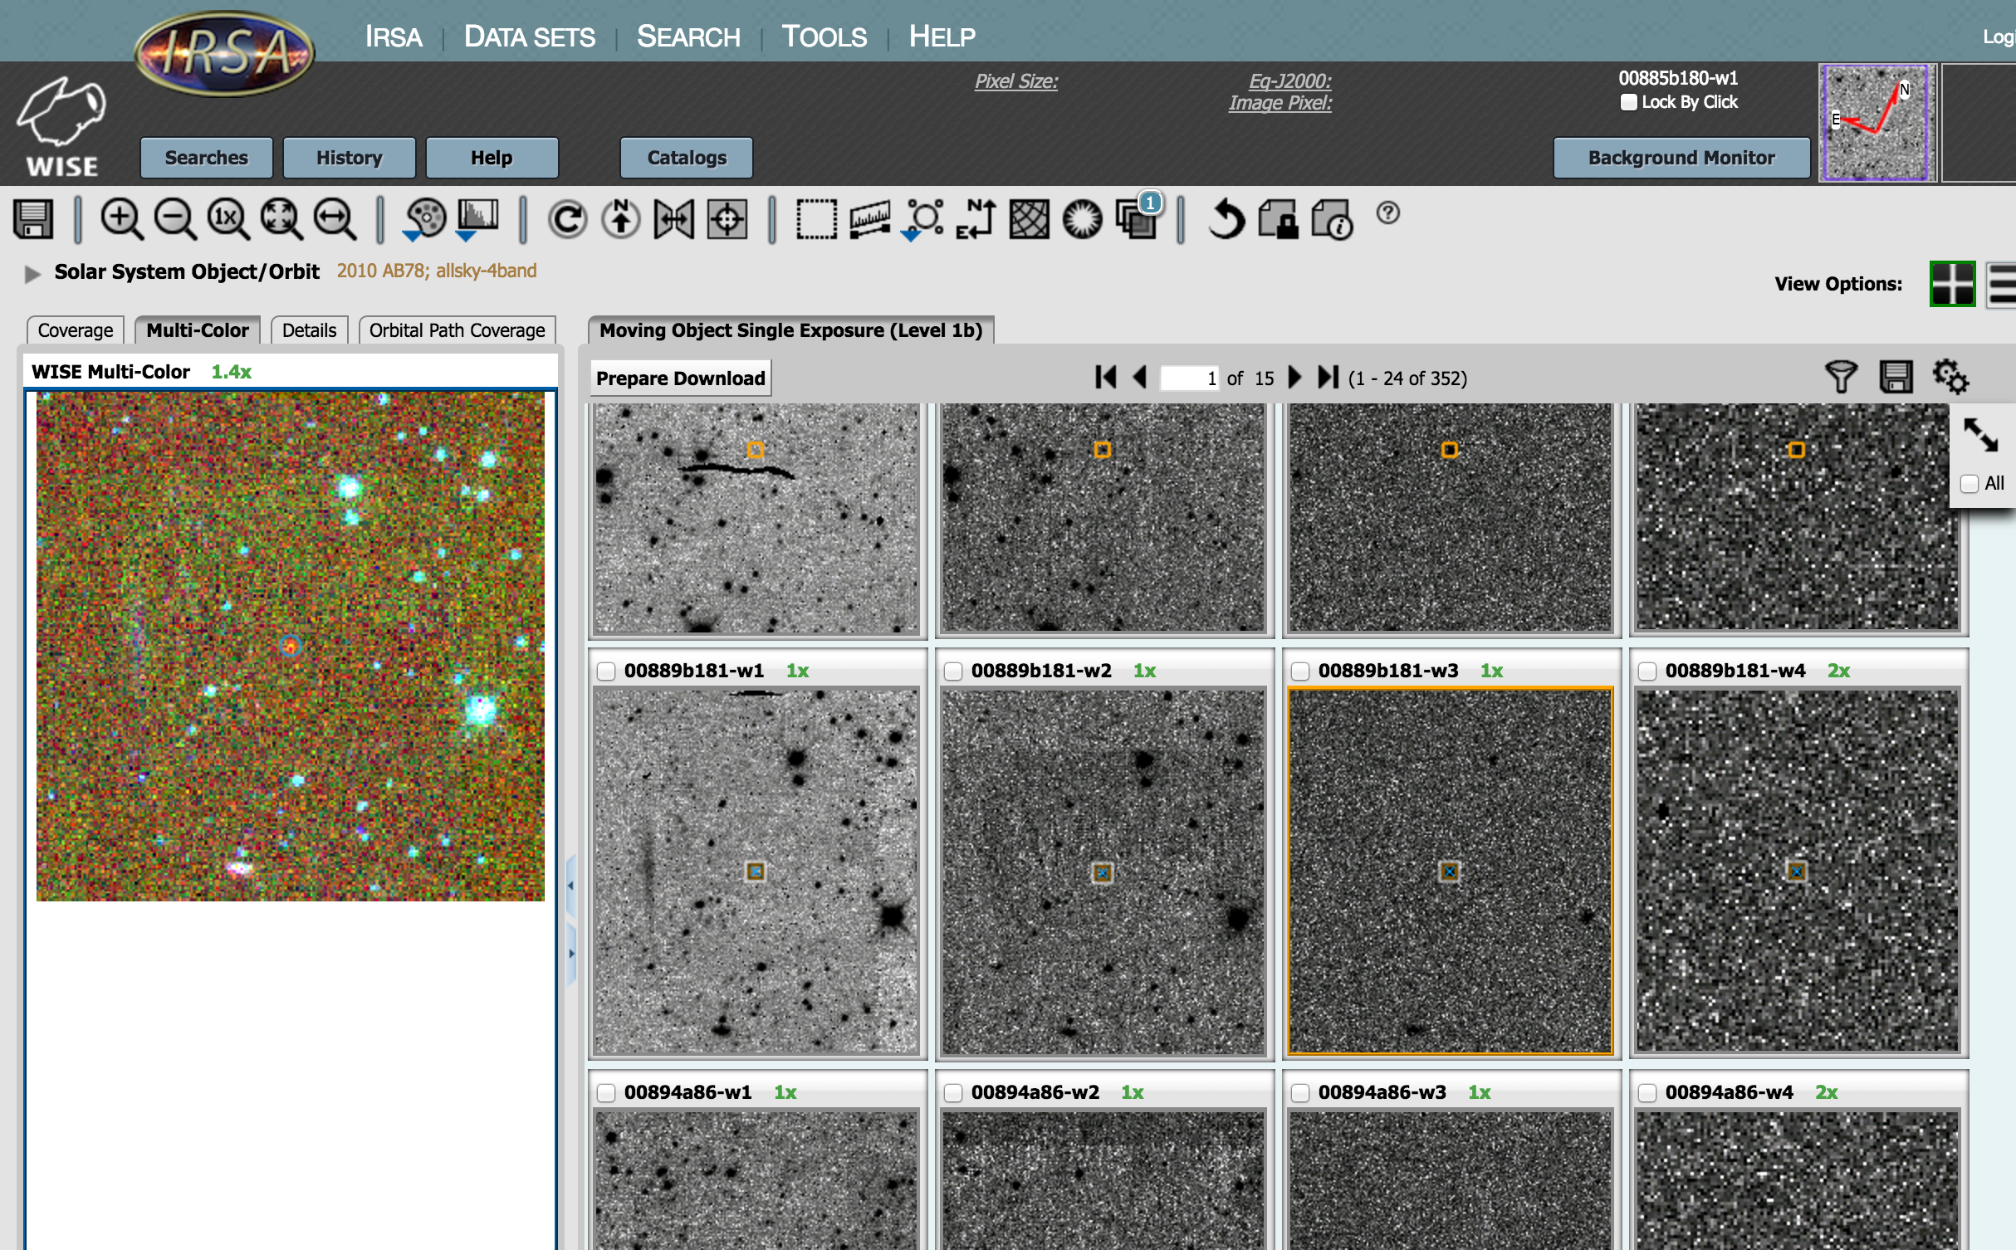
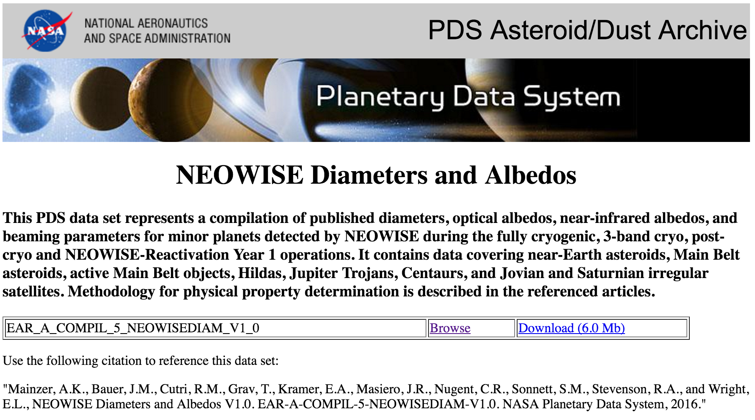
How to get the data
NASA Planetary Data System hosts the derived physical properties previously published
Source catalogs, single frame images, and atlas images are hosted on the NASA/IPAC Infrared Science Archive

Slide 20
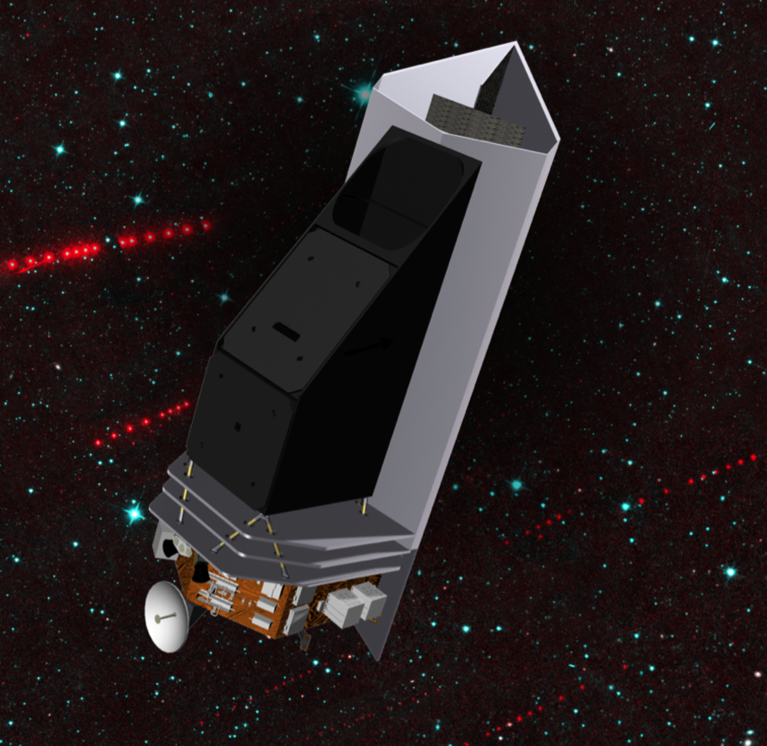
The next generation
The Near-Earth Object Camera: NEOCam
PI: Amy Mainzer (JPL)
50 cm telescope
Two 16 megapixel HgCdTe focal planes at 4-5.4 & 6-10 μm simultaneously imaged
Sun-Earth L1 orbit
Detectors passively cooled to 40K
Would detect ~100,000 NEOs, >2 million MBAs
Would expand on the results of NEOWISE while providing a census of hazardous NEOs
Currently in Step 2 competition for Discovery
NASA JPL
Pre-Decisional Information -- For Planning and Discussion Purposes Only

Slide 21
Conclusions
NEOWISE provides a treasure trove of data on asteroids and comets, as well as stars and galaxies
Near Earth Objects trace the physical and dynamical processes that have sculpted the Solar System since formation
Infrared surveys allow us to determine physical properties for an unprecedented number of Solar system objects
Albedos provides critical information on asteroid composition, family association and can be used to trace origins

